Slide 1

Careers in Academia
Inimary Toby, PhD
Assistant Professor
UD Bioinformatics

Slide 2
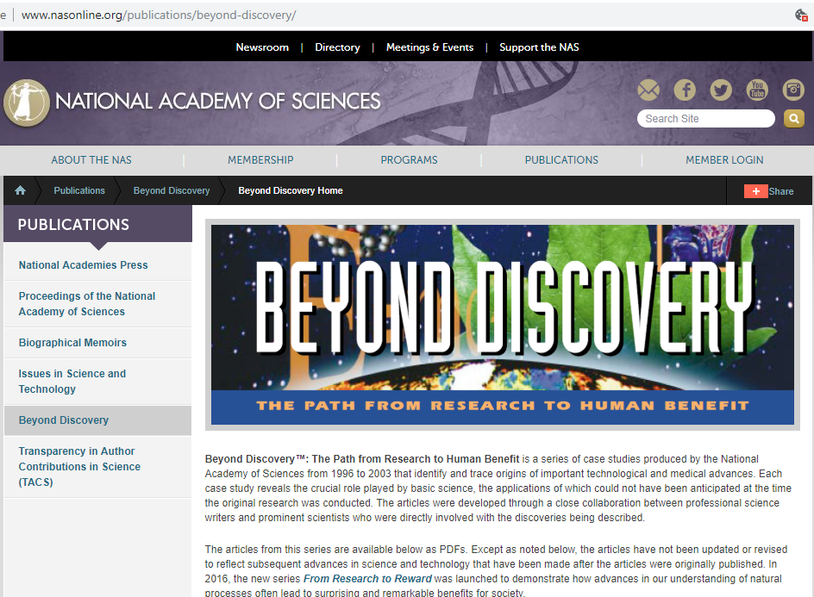

Slide 3
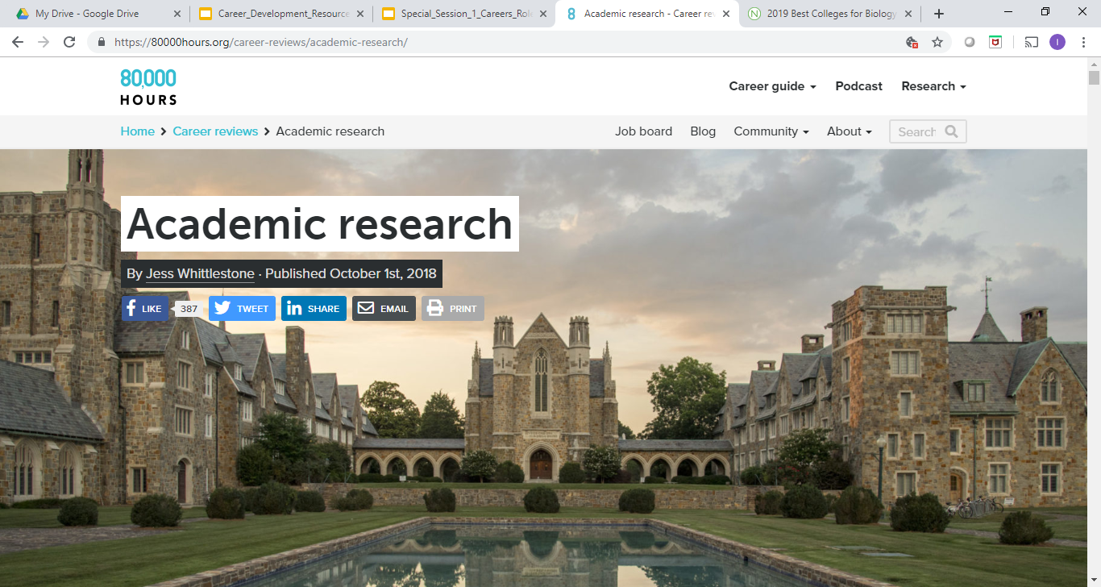

Slide 4
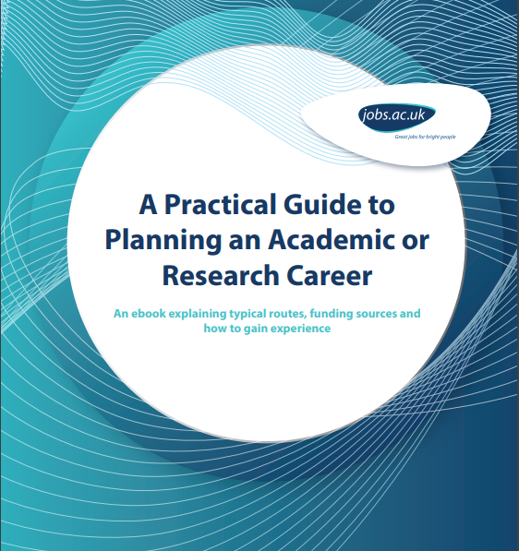
https://www.jobs.ac.uk/media/pdf/careers/resources/a-practical-guide-to-planning-an-academic-or-research-career.pdf

Slide 5
Words of wisdom
The deep unteachable skill is that you’ll learn how to motivate yourself, how to drive and guide your own work (for if you don’t learn this, getting a PhD will be tough). Decide what to prioritize; be creative; turn ideas into actions.
These skill are fundamental to leadership and entrepreneurship, which is the mindset that all countries crave in their workforce.

Slide 6
The role of education in Bioinformatics
http://biomedicalcomputationreview.org/content/landscape-bioinformatics-education

Slide 7
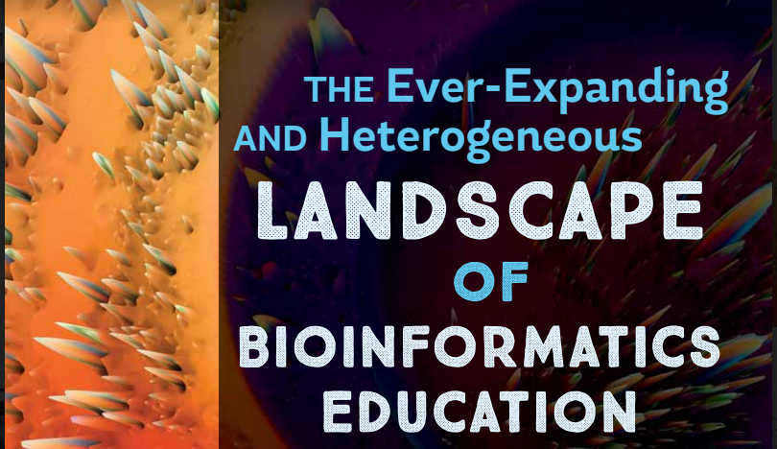
http://biomedicalcomputationreview.org/content/landscape-bioinformatics-education

Slide 8
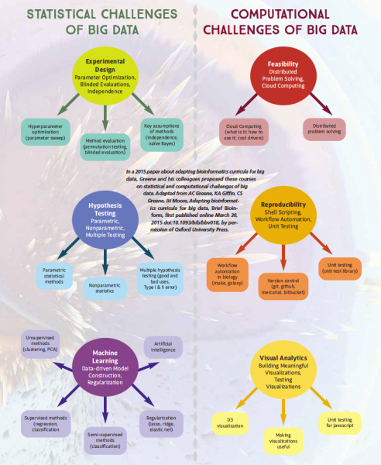

Slide 9
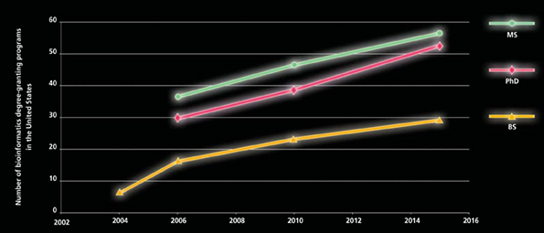

Slide 10
Workflow Model for Research Universities

Slide 11
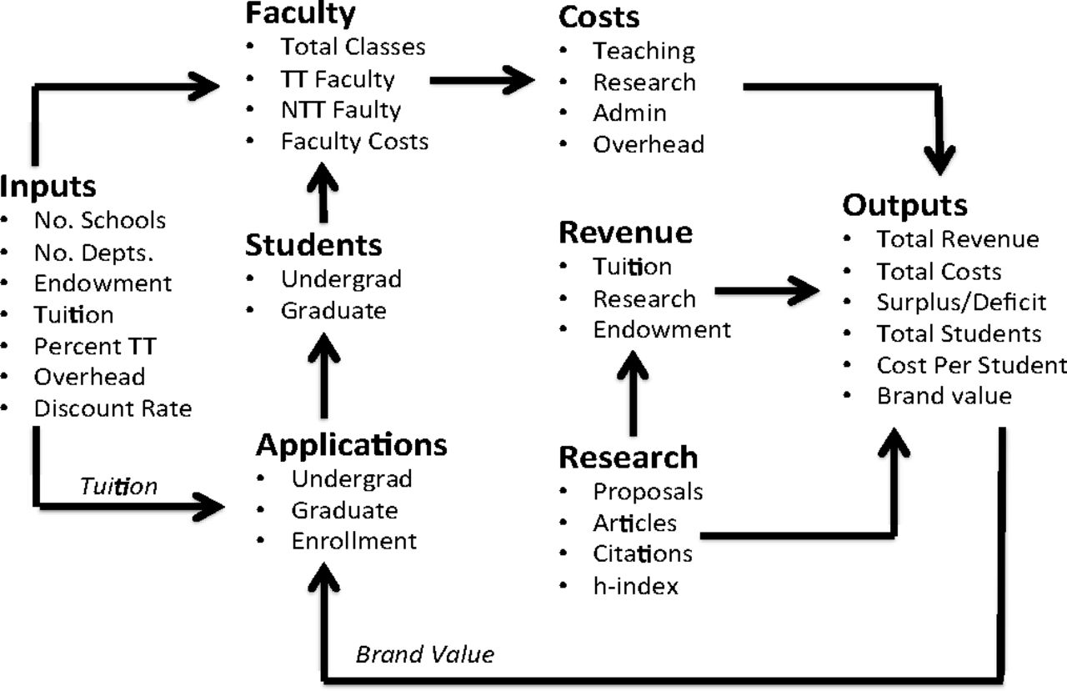

Slide 12
Large universities and Small universities

Slide 13
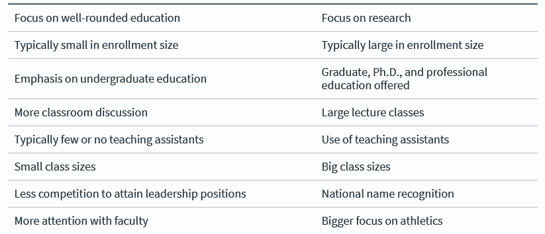
Small Universities
Large Universities

Slide 14
Large public universities

Slide 15
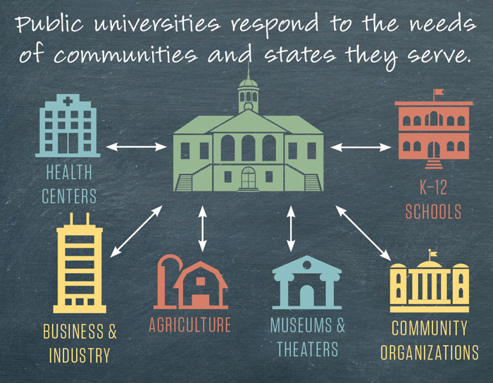

Slide 16
Identifying the position desired
Larger universities:
Some example postings:
Computational Biologist (I, II, III, IV)
Mathematical Biologist
Bioinformatics Analyst
Data analyst
Project manager in Bioinformatics
Programmer

Slide 17

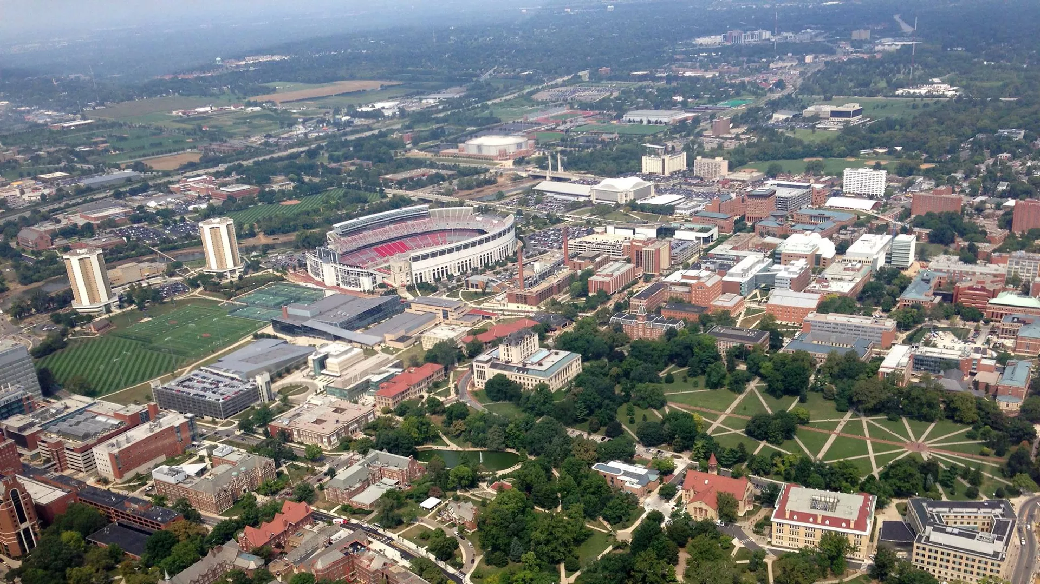

Examples

Slide 18
Small private universities

Slide 19
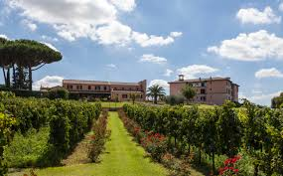
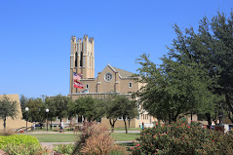
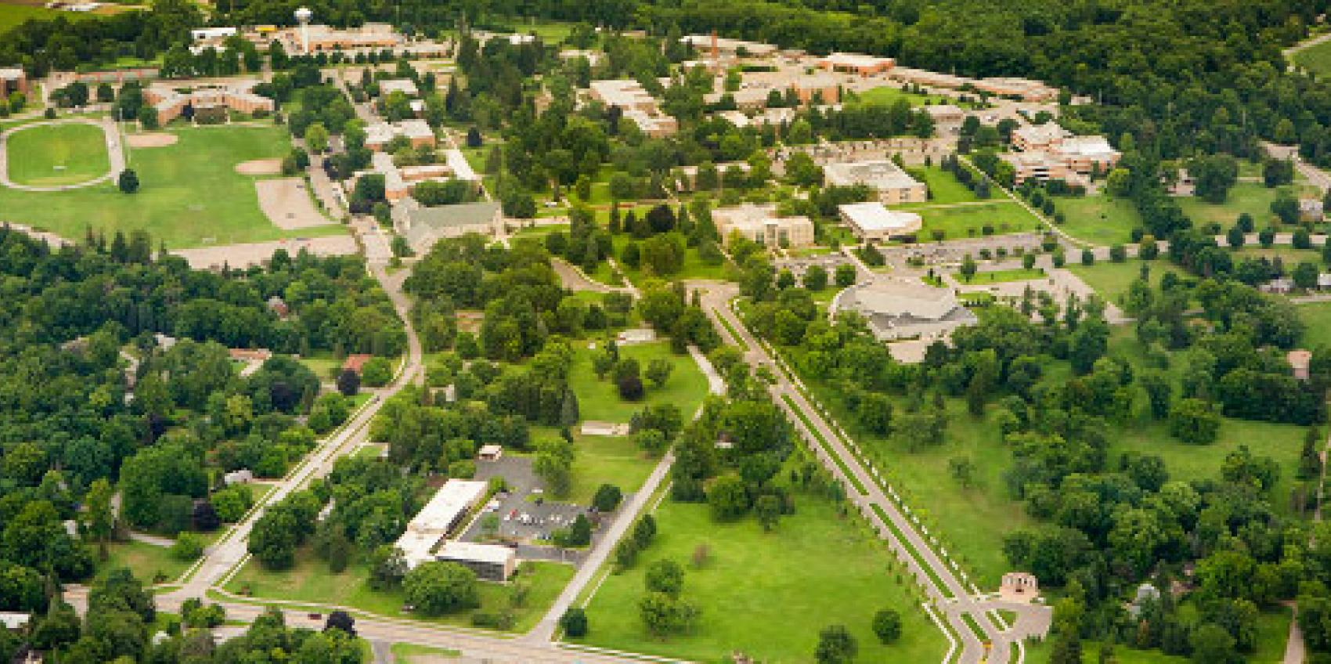

Examples

Slide 20
Example job postings
Assistant Professor/Associate Professor (Tenure track)
Non Tenure track vs Tenure track
Affiliate Faculty vs. Adjunct Faculty- most common for short term masters/PhD level guest instructors

Slide 21
Example job postings
Instructor- most commonly used in lower division courses or at 2 year universities
Lecturer- not commonly used; may be used in select institutions to denote a term position (i.e 1 year, 2 year etc.)
Senior Lecturer- not commonly used; may be used to denote a term position for a senior level PhD scientist with many years experience (Ex. to help in a newly established degree program such as online etc.)

Slide 22
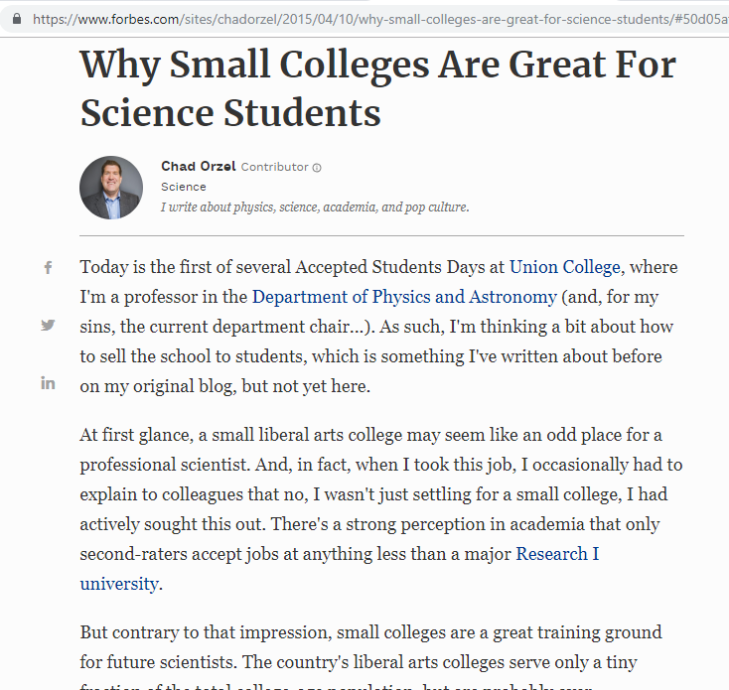

Slide 23


Slide 24
Applying for positions

Slide 25
Key Components of the job application
Connecting with the HR (hiring manager) and verifying requirements
The Resume vs Curriculum Vitae
The Research Statement
The Teaching statement
Background research (related to interviewing/campus visit)
The interview process (in brief)

Slide 26
Key Components of the job application
Connecting with the HR (hiring manager) and verifying requirements
The Resume vs Curriculum Vitae
The Research Statement
The Teaching statement
Background research (related to interviewing/campus visit)
The interview process (in brief)

Slide 27

Connecting with the HR (hiring manager)

Slide 28
Key Components of the job application
Connecting with the HR (hiring manager) and verifying requirements
The Resume vs Curriculum Vitae
The Research Statement (Research Plan)
The Teaching statement
Background research (interviewing/campus visit)
The interview process
The job talk

Slide 29
Resume vs curriculum vitae
A CV (Curriculum Vitæ, which means course of life in Latin) is an in-depth document that can be laid out over two or more pages and it contains a high level of detail about your achievements, a great deal more than just a career biography.
covers your education as well as any other accomplishments like publications, awards, honours etc.
Tends to be organised chronologically;
should make it easy to get an overview of an individual’s full working career;
is static and doesn’t change for different positions, (difference is in the cover letter).

Slide 30
Resume vs Curriculum Vitae
Resume:
A resume, or résumé, is a concise document typically not longer than one page as the intended the reader will not dwell on your document for very long.
Goal is to make an individual stand out from the competition.
Should be adapted to every position apply for.
Doesn’t have to be ordered chronologically, doesn’t have to cover your whole career like and is a highly customisable document.

Slide 31
Resume vs Curriculum Vitae
Academic faculty positions will require a CV
Other types of positions such as at the staff scientist level (ex. Analyst, programmer etc.) will want a resume

Slide 32
Key Components of the job application
Connecting with the HR (hiring manager) and verifying requirements
The Resume vs Curriculum Vitae
The Research Statement (Research Plan)
The Teaching statement
Background research (interviewing/campus visit)
The interview process
The job talk

Slide 33
Research Statement
In a research statement for a faculty job, you have to explain your research trajectory — past, present, and future — in a balanced way.
Begin the statement with a short paragraph of overview of your research themes and topics.
https://chroniclevitae.com/news/1156-the-professor-is-in-research-plans-proposals-and-statements

Slide 34

Research Plan
https://www.sciencemag.org/careers/2002/07/writing-research-plan

Slide 35
Research Plan
Contributes to your development as a scientist.
Serves as a map for your career as a research science professional.
Demonstrates your intellectual vision and aspirations.
Demonstrates the creative and independent thinking required of a successful scientist.

Slide 36
Key Components of the job application
Connecting with the HR (hiring manager) and verifying requirements
The Resume vs Curriculum Vitae
The Research Statement (Research Plan)
The Teaching statement
Background research (interviewing/campus visit)
The interview process
The job talk

Slide 37


Slide 38
Teaching Statement
A Teaching Statement is a purposeful and reflective essay about the author’s teaching beliefs and practices.
Individual narrative that includes beliefs about the teaching and learning process,
concrete examples of enacting these beliefs in the classroom,
Gives a clear and unique portrait of the author as a teacher.
https://wp0.vanderbilt.edu/cft/guides-sub-pages/teaching-statements/

Slide 39
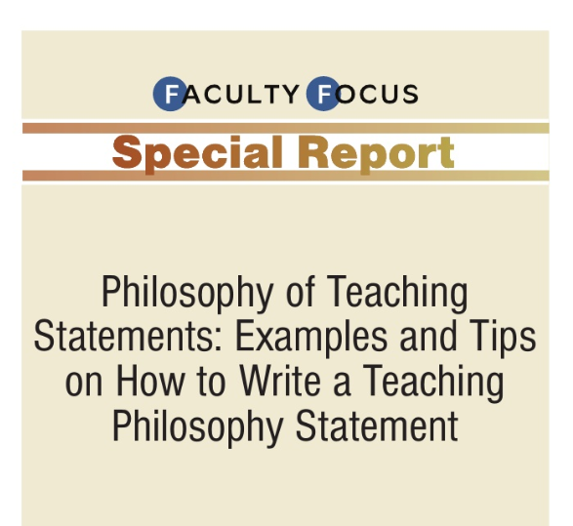
Teaching statement
https://www.slideshare.net/ccharles/faculty-focus-special-report-philosophy-of-teaching-statements

Slide 40
Key Components of the job application
Connecting with the HR (hiring manager) and verifying requirements
The Resume vs Curriculum Vitae
The Research Statement (Research Plan)
The Teaching statement
Background research (interviewing/campus visit)
The interview process
The job talk

Slide 41

Background Research prior to campus visit

Slide 42
Interviewing process (the on-campus interview)
The polls have closed and the returns are in. The search committee has completed its task. It has debated, voted, and compiled a rank-ordered list of the top eight to ten candidates.
Interested members of the department will have a week or two to look at these files before they convene as a whole (often more than once), and decide whom to invite for an on-campus interview.

Slide 43
Key Components of the job application
Connecting with the HR (hiring manager) and verifying requirements
The Resume vs Curriculum Vitae
The Research Statement (Research Plan)
The Teaching statement
Background research (interviewing/campus visit)
The interview process
The job talk

Slide 44
The Job Talk
An important part of your goal during the on-campus visit is to demonstrate that you would be an interesting and congenial colleague, and a productive, functioning member of the department and campus community.
Other meetings include:
stop at human resources where you will learn all about the dental and pension plans;
a session with a student committee or two;
the library;
and finally (usually at about 4:00pm) comes the job talk.

Slide 45
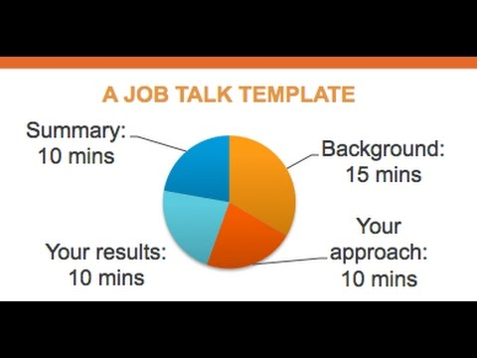

Slide 46
What occurs on the back-end?

Slide 47
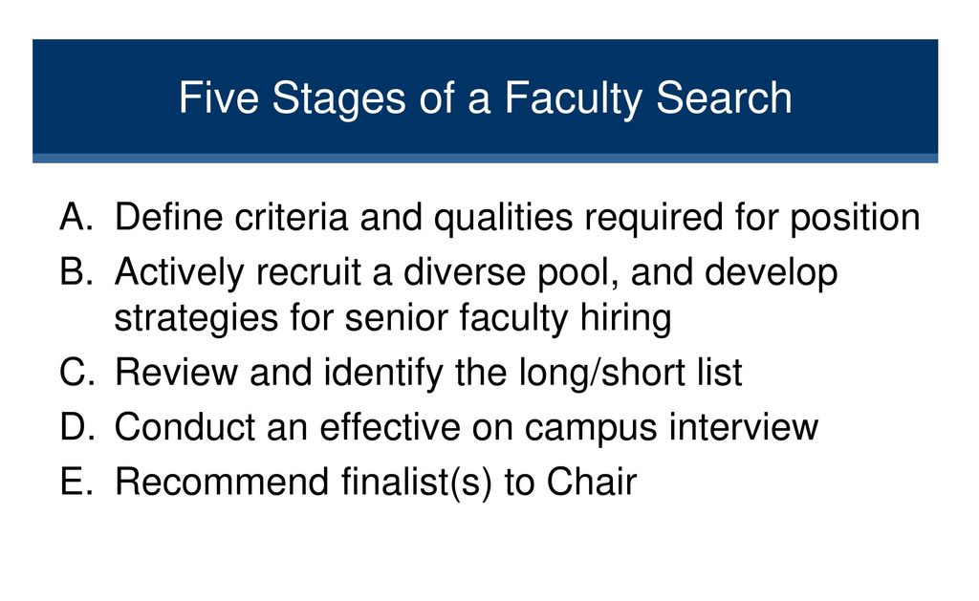

Slide 48
Closing remarks
Importance of getting information from HR/hiring manager
Preparation of a draft application and obtain 3 external reviews to better refine it
Be sure application materials are very clear in addressing the job expectations prior to submission
Connect with the Faculty member in charge of the recruitment for follow-up

